Slide 1
York Music Hub
Network Event
4th July 2024
4:00pm - Arrival and registration
4:10pm - Welcome and introductions (Helen Minors YSJ)
4:20pm - Rachel Shapey - I Can Compose: Teaching Composition in the Classroom
5:05pm - York Music Hub Bingo!
5:15pm - Seek and Find!
5:30pm - Refreshments and time to Celebrate
5:45pm - Meeting closed

Slide 2
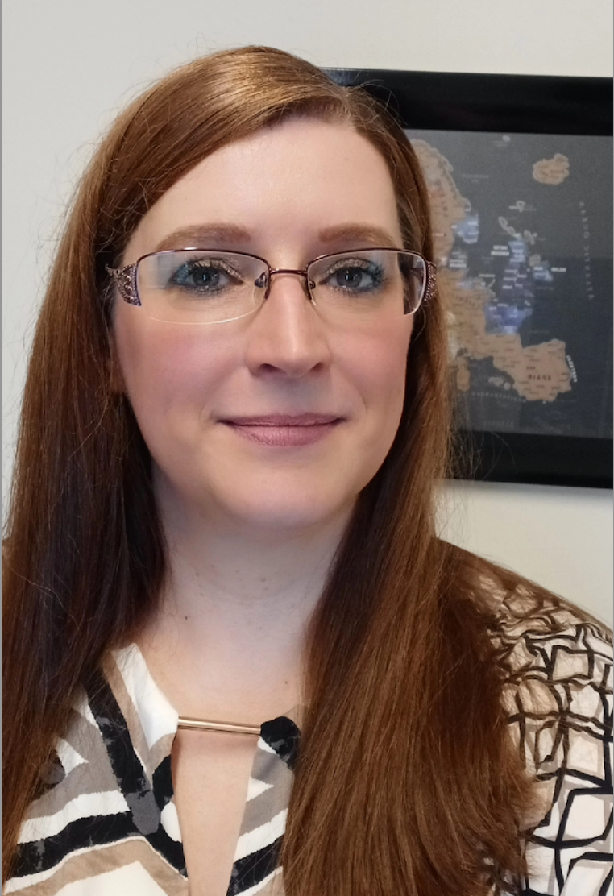
Welcome
Helen Minors is a Professor and Head of School of the Arts at York St John University. She is also a visiting Professor of artistic research at Lulea Technical University, Sweden. She is a founder and original co-chair of EDI Music Studies Network and former chair and vice chair of MusicHE.
This year, Helen became a York Music Hub Trustee and is excited to see future developments of Music Education in York.

Slide 3
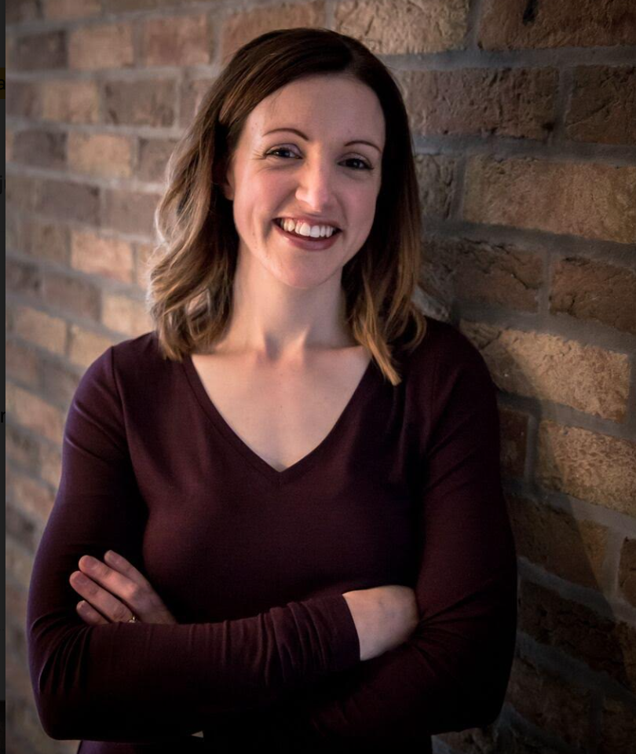
Rachel Shapey
I Can Compose:
Teaching Composition in the Classroom
I Can Compose is a unique educational resource designed by music teachers, for music teachers.
It brings together informative, educational composition resources you wont find anywhere else.
We all know how challenging teaching composition in the classroom can be, so here is some help to make you feel confident in doing so.

Slide 4
Creative Approaches for teaching Classroom Composing
York
_______________
4 July 2024
Rachel Shapey, I Can Compose

Slide 5
Integrated approach
__________________
Listening
Analysing
Performing
Composing

Slide 6
Warm up - KS2+KS3
__________________
Notes:
Rain dance - texture, dynamics, focus, posture, soundscape

Slide 7
Rain dance
__________________
Dynamics
Posture
Body percussion
Listening skills / focus
Texture
Describing sound
Notes:
Rain dance - texture, dynamics, focus, posture, soundscape

Slide 8
Notes:
Necessary to bring in a more prescriptive approach - will look different for every teacher

Slide 9
Active Listening
__________________
Listening
Analysing
In pairs or threes, open your envelope & spread out the cards.
Put each colour together in the same area.

Slide 10
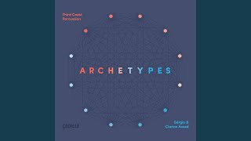
Active Listening
__________________
Listening
Analysing
As you listen:
Choose the following to apply to the music:
- 1 yellow ‘character’ card
- 3 green cards
- 3 blue cards
How many surprises can you find?
Write them down!

Slide 11
Active Listening
__________________
Listening
Analysing
Which green cards did you choose and why?
Which blue cards did you choose?
What surprises did you find?
(Put your yellow card to one side)

Slide 12
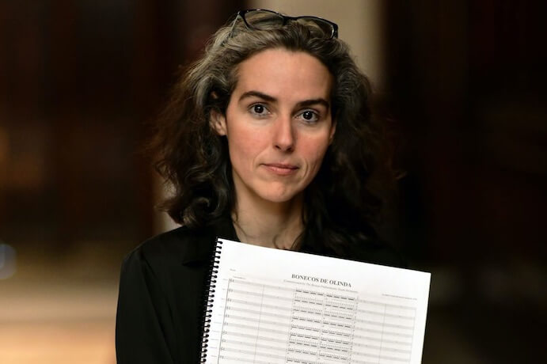
A movement from
‘Archetypes’
By Clarice Assad
__________________
Listening
Analysing
Assad is a Grammy-award nominated Brazilian-American composer
She worked with her father and ‘Third Coast Percussion’ ensemble to create Archetypes.

Slide 13
Let’s explore….
What is an archetype?
__________________
Analysing
What is a character trait?
Use positive examples within the class:
“Adam is hard-working, funny and very kind.”
“Vanisha is thoughtful and always ready to help”

Slide 14
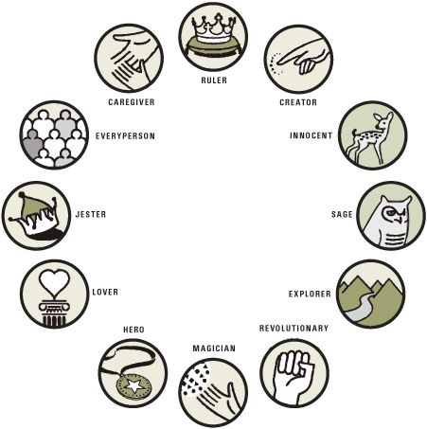

Slide 15
Exploring Archetypes
__________________
Analysing
Explorer
What character traits would you expect an explorer to have?
What might an explorer’s strengths and weakness be?

Slide 16
Exploring Archetypes
__________________
Analysing
Hero
What traits would you expect a hero to have?
What might a hero’s strengths and weaknesses be?

Slide 17
Which archetype?
__________________
Listening
Analysing
Which archetype do
you think this is?
Why?

Slide 18
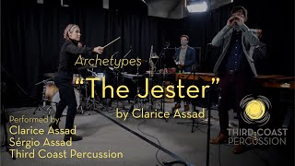
Jester
__________________
Listening
Analysing
What is a jester?
What does he do?
What do you think his character traits are?
How is that shown in the music?

Slide 20
Rhythm
__________________
Performing / playing
 | 1 | 2 | 3 | 4 | 5 | 6 | 7 | 8
Part A | ⚫ | ⚫ | ⚫ |  | ⚫ | ⚫ | ⚫
Part B | ✖ ✖ | ✖ ✖ |  | ✖ ✖ | ✖ ✖ | ✖ ✖ |  | ✖ ✖
Part C |  |  | ♥ ♥ ♥ ♥ |  |  | ♥ ♥ ♥ ♥
Key:
⚫ - foot stamp
✖ - knee slap
♥ - hand clap

Slide 21
Differentiation
__________________
Performing
Add more parts
Vary the body percussion actions e.g shoulder tap; finger click; chest tap
Subdivide the beats

Slide 22
Paired Task (if time)
Performing
Create your own ostinato rhythm grid to perform
Suggestion:
1 part will have 1 symbol per box
1 part will have 2 symbols per box
1 part could have 4 symbols per box
 | 1 | 2 | 3 | 4 | 5 | 6 | 7 | 8
Part A
Part B
Part C

Slide 23
Differentiation
Performing
Use 4 rather than 8 beats / subdivide beats (1 + 2 + etc)
Use grids with 2 parts / increase number of parts.
Hand out grids with 1 part done and 1 part to fill in.
Have some simple ready-made rhythm grids ready.

Slide 25
Composing:
Exploring sound and character
__________________
Composing

Slide 26
Composing:
Exploring sound
__________________
Composing
Project 1
Project 2
Compose a ‘surprise’ piece
Use your rhythm grid and found sounds to compose a piece with a surprise for the listener!
Compose music for a different archetype
Choose an archetype e.g explorer or hero and compose a 1 minute piece to portray this character type.

Slide 27
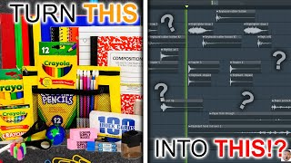
Found sounds
__________________
Composing
“Using an everyday ‘non-musical’ object creatively in a piece of music.”
https://www.bbc.co.uk/teach/class-clips-video/music-ks3-finding-sounds-around-you-to-create-music/zkp347h

Slide 28
Classroom Alternatives
__________________
Composing
Provide some more unusual instruments or explore different playing techniques of available instruments.
For a digital project, use handheld recorders / iPads / phones to record sounds around school. Import into a DAW and arrange.

Slide 29
Find your sound!
__________________
Composing
Look around you.
Which objects could become ‘instruments’?
Can you try different ways of playing them?
Explore!
Extension: try performing your rhythm grid using your found sounds.

Slide 30
Composing task - 4 in a group
__________________
Composing
Compose a short ‘suprise’ piece using percussion / body percussion
and found sounds.
What will your musical surprise be?
Your piece will have 2 or 3 sections. How will you make your sections different?

Slide 31
Composing task - suggested structure
__________________
Composing
Start:
Steady pulse
Rhythm grid twice; enters after 4 beats.
Middle:
Rhythm grid continues. Found sound 1 enters over the top.
Found sound 2 enters.
Surprise!
Ending:
Rhythm parts drop out one by one.
Found sound - surprise?

Slide 32
Example Success Criteria
__________________
Composing
✓ Everyone must have a musical role in the group
✓ Have a clear start, middle and end.
✓ Include 2 ostinato patterns
✓ Include a musical surprise

Slide 33
Key words
__________________
Composing
Ostinato
Pulse
Rest
Ensemble
Structure
Found sound

Slide 34
Calendar Dates Autumn Term
 | Monday 2nd September | Approved Tutor Day
 | Virtual - Wednesday 25th September | YMH Update Meeting
 | Thursday 3rd October | Primary Meet-Up
 | Thursday 24th October | Music Hub Gala Evening
 | Saturday 9th November | Brass Day
 | Deadline 20th November | Minster Christmas Tree Festival
 | Friday 6th December | A Grand Georgian Christmas with Gabrieli Roar

Slide 35
YMH Bingo!
Remember to shout BINGO!
First to a row wins a fantastic book from one of our own -
Karen Marshall: Her story The Piano Collection
We continue on, for second and third prize of York Music Hub Pen.

Slide 36
YMH Bingo!
98% school engagement this year!
43% of primaries deliver WCET
1650 children having WCET
19 schools in Choral Festival
YMH own Instrumental Hire service
500 children in Choral Festival
10 schools in Playground Proms
63% of schools summer performance funded by YMH
154 bursaries awarded this year
Official merger with North Yorkshire
52% Music Leads have attended a Meet-up this academic year
18 Partner Project Fund awarded
3 x Primary Meetups each year
5 Merchant Taylor Bursaries
£30K support extra-curricular through PPF

Slide 37
YMH Bingo!
Partner: National Centre of Early Music
Partner: Orchestra and the Age of Enlightenment
Partner: York University
Partner: York St John
Partner: York Music Education
Partner: AMP
New ensemble: Bargestra
3 x Schools Minster Singing Programme
Steel Pan ensemble Knavesmire
Successful Music Deep Dives
OAE 400 children
2 Yorkshire Young Musicians bursaries
Follow us on Social Media
Experienced Trustees
Learning Leader support 66% of all schools
4 x Class Sets of Ukuleles to hire

Slide 38
YMH Bingo!
Become a friend: Bronze, Silver & Gold
£311K to spend on instruments
Monthly Newsletter
Free YGO tickets
Free Instruments of the Orchestra session
Partner: RSMF
Free Choral Session - CHYC
Lowest risk rating for a Hub
422 students has instrumental tuition
More than 12 hours of CPD
More than 165 ensembles across school
Upto 1000 children in ensembles
Hub Gala event 24th October
Rebrand ‘Workshop’ (Masterclasses)
Subsidised Sing-up subscription
Music library
Over £10K in fundraising this academic year

Slide 39
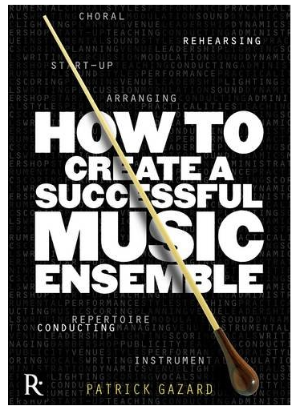
YMH Seek and Find!
Time to complete your
Seek and Find cards!
First to answer all 5 networking questions wins…..
Patrick Gazard (Soon to be one of our own)
‘How to create a Successful Music Ensemble’

Slide 40
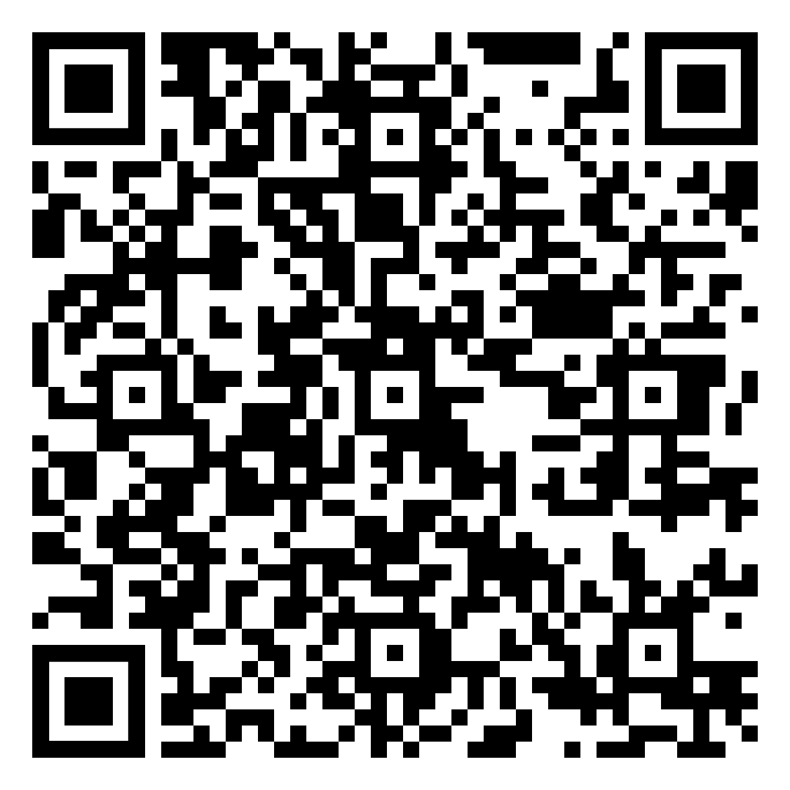
Thank You!
York Music Hub would like to thank every Music Teacher and Partner for their incredible work with children and young people of York!
You are a great team!
If you would like to give us your feedback
Please scan here!
Please enjoy some light refreshments from all at The York Music Hub.

